Slide 1
Session 11 TWO LEVEL FRACTIONAL FACTORIAL DESIGN

Slide 2
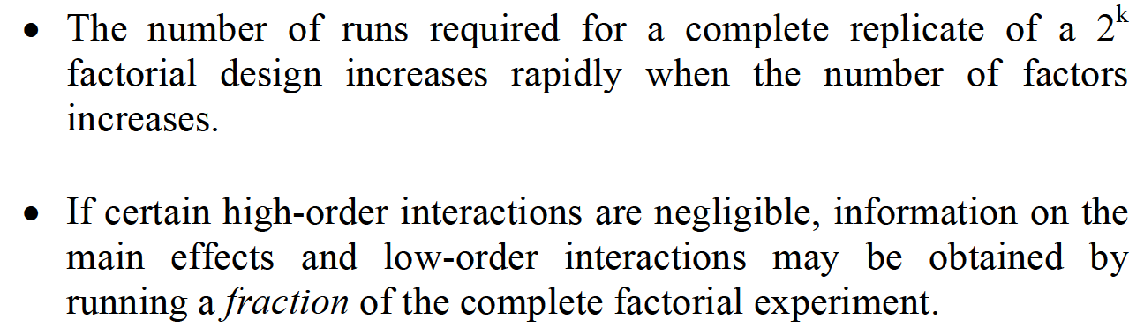
WHY FRACTIONAL DESIGN ?

Slide 3
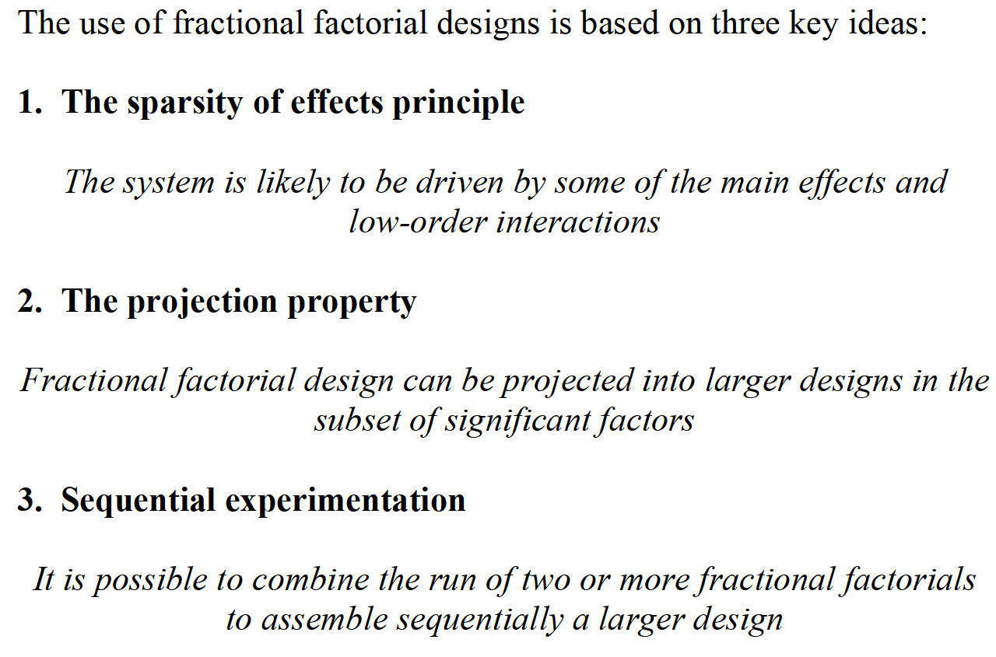
WHY FRACTIONAL DESIGN ?

Slide 4
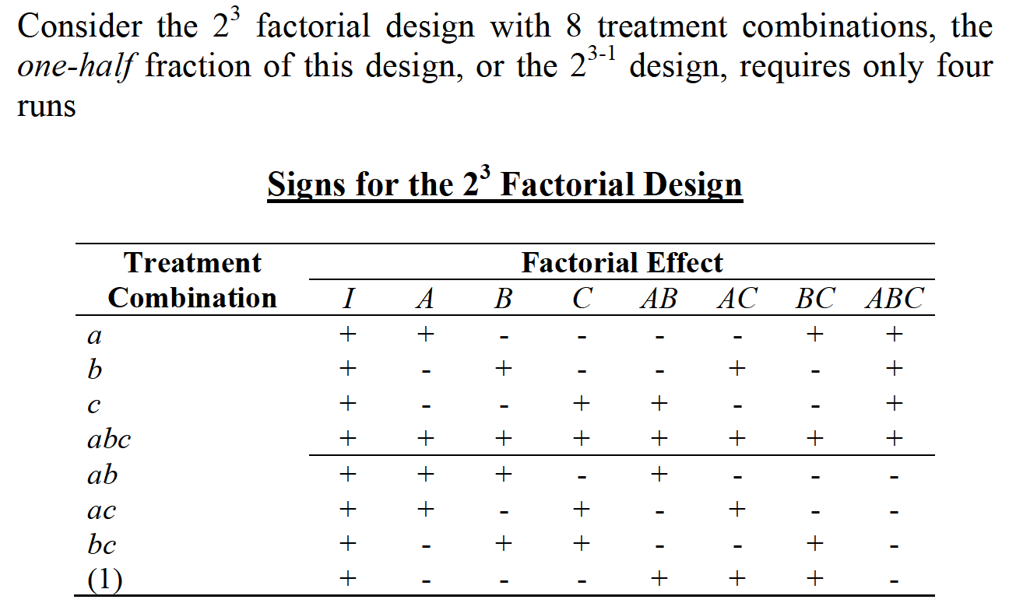
ONE-HALF FRACTION DESIGN

Slide 5
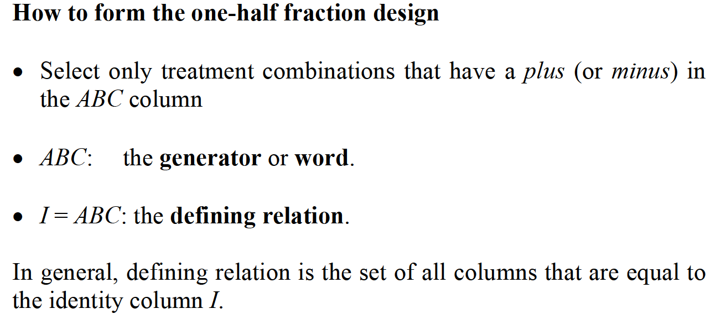
ONE-HALF FRACTION DESIGN

Slide 6
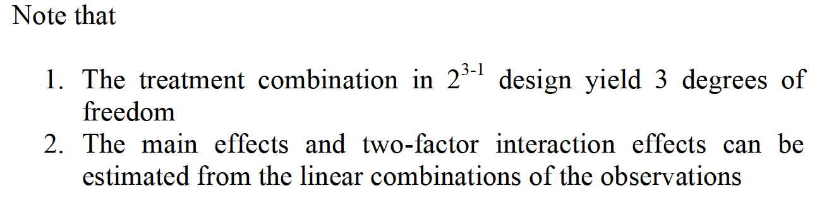
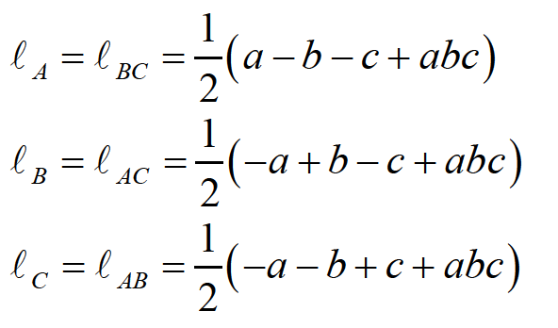
ONE-HALF FRACTION DESIGN

Slide 7
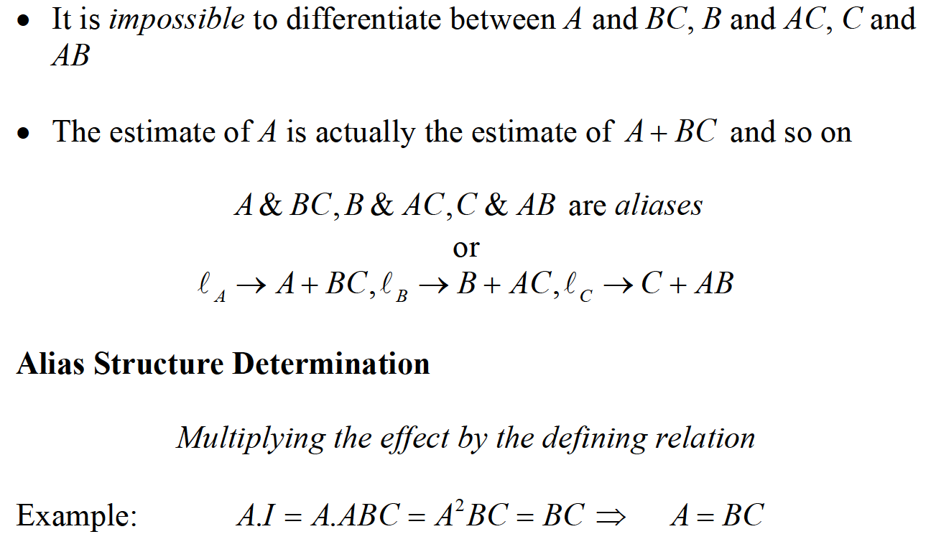
ONE-HALF FRACTION DESIGN

Slide 8
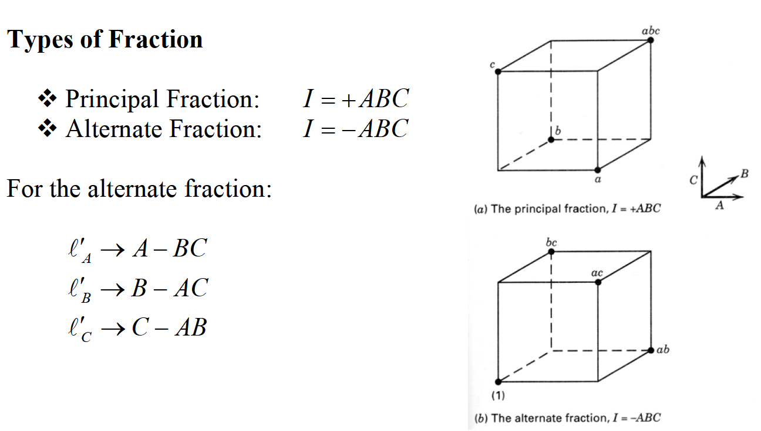
ONE-HALF FRACTION DESIGN

Slide 9
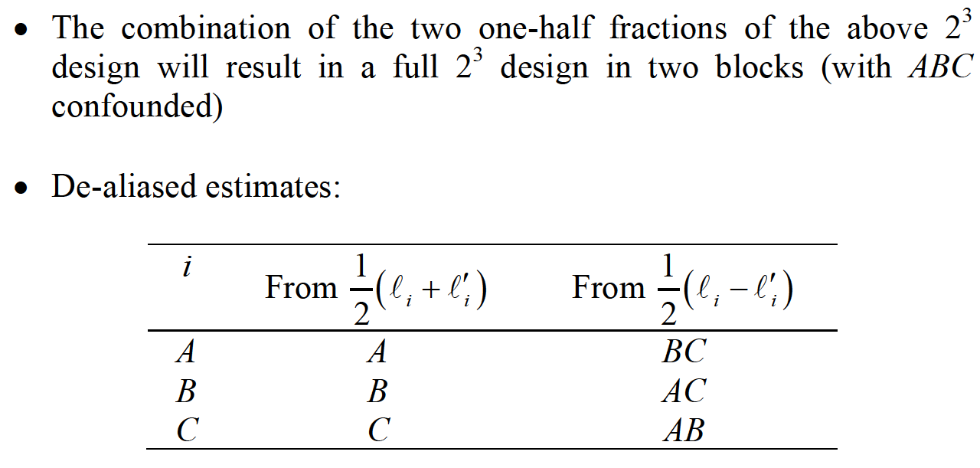
ONE-HALF FRACTION DESIGN

Slide 10
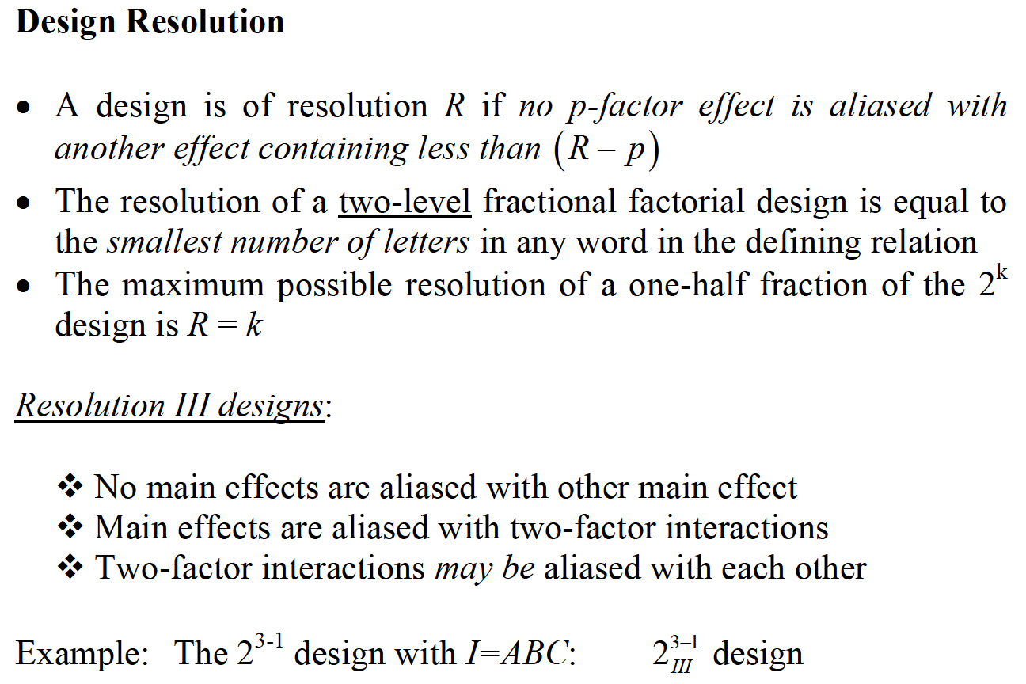
ONE-HALF FRACTION DESIGN

Slide 11
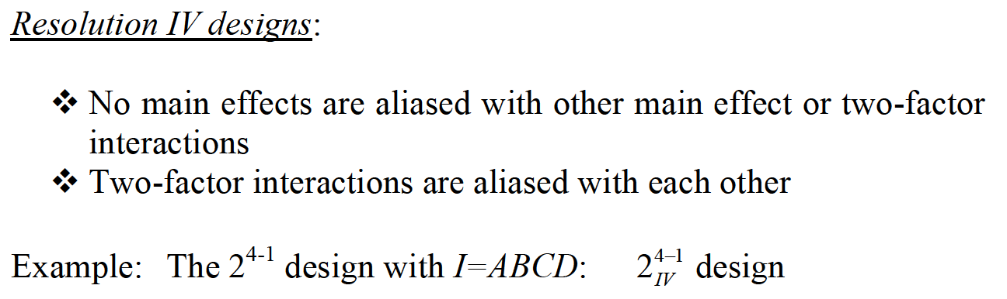
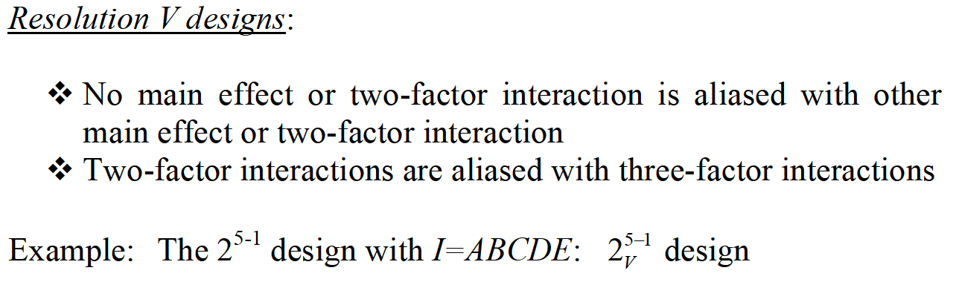
ONE-HALF FRACTION DESIGN

Slide 12
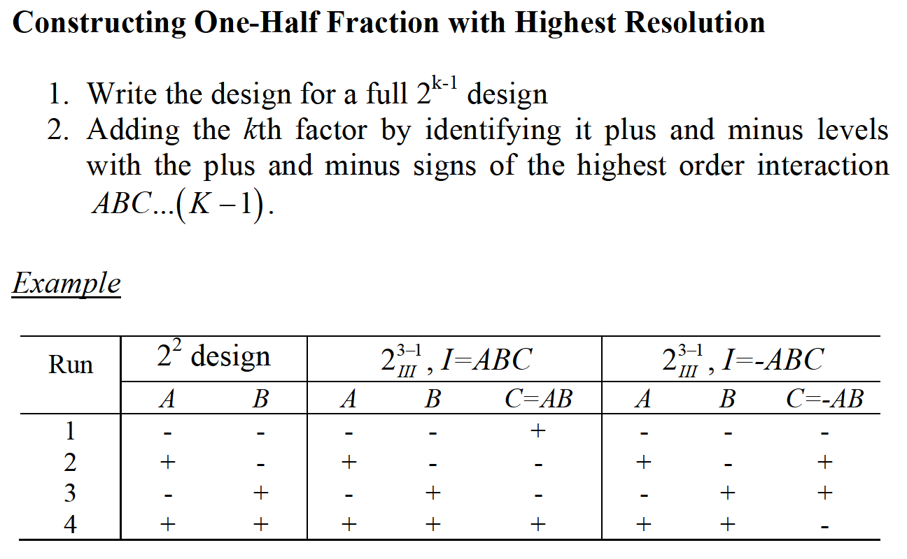
ONE-HALF FRACTION DESIGN

Slide 13
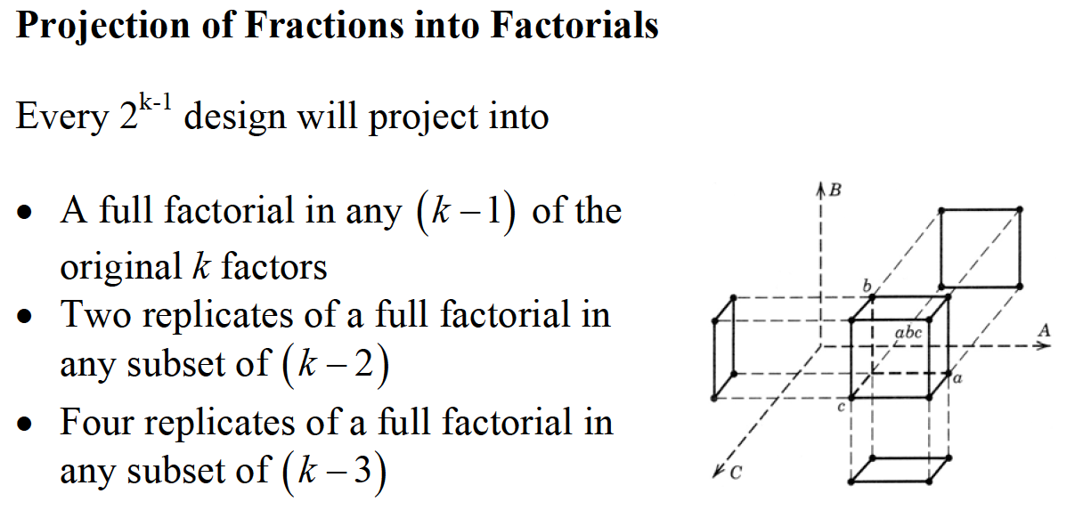
ONE-HALF FRACTION DESIGN

Slide 14
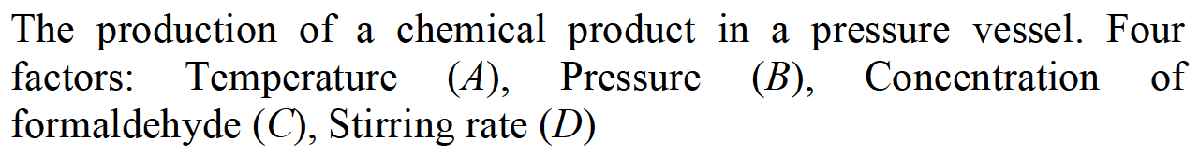
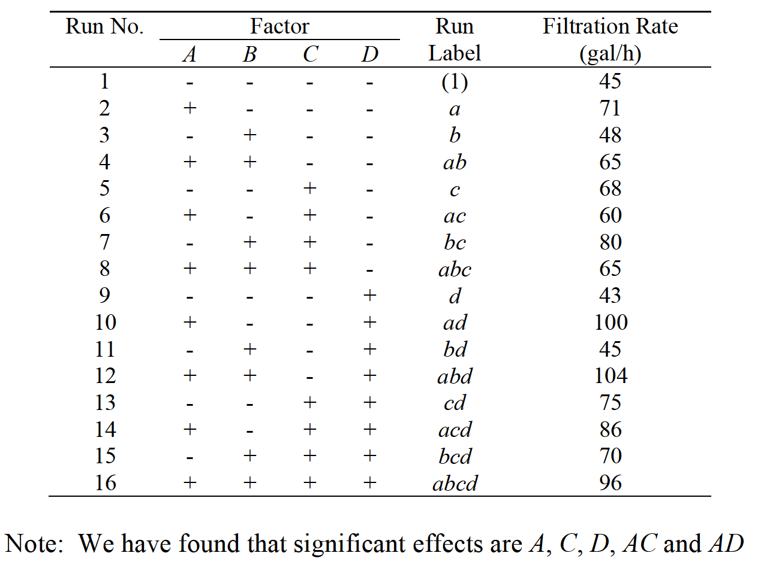
ONE-HALF FRACTION DESIGN

Slide 15
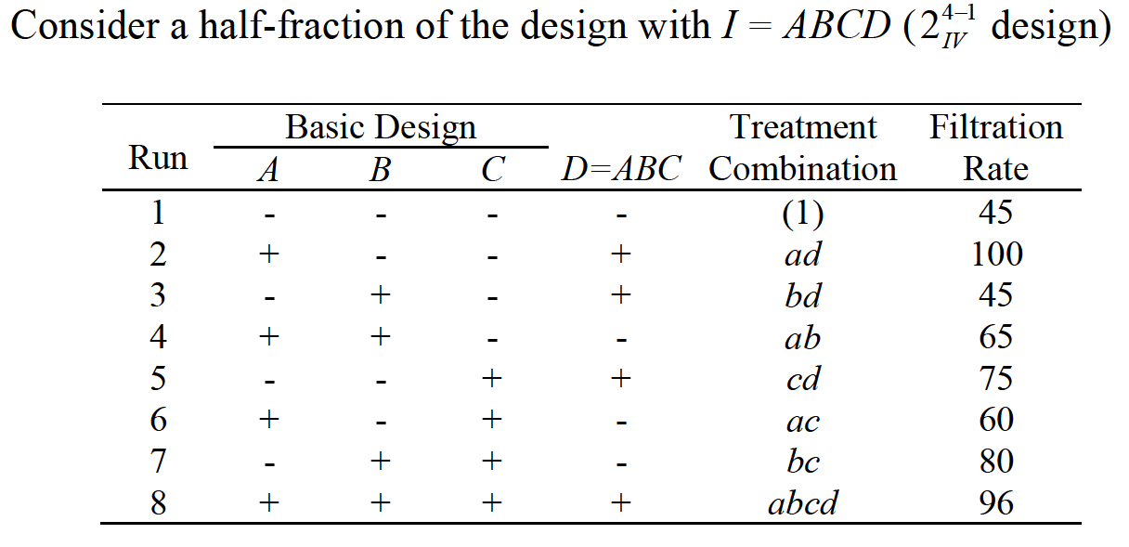
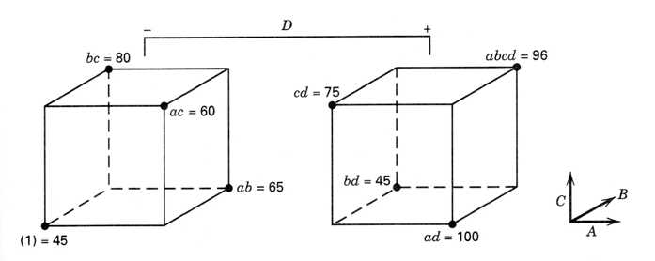
ONE-HALF FRACTION DESIGN

Slide 16
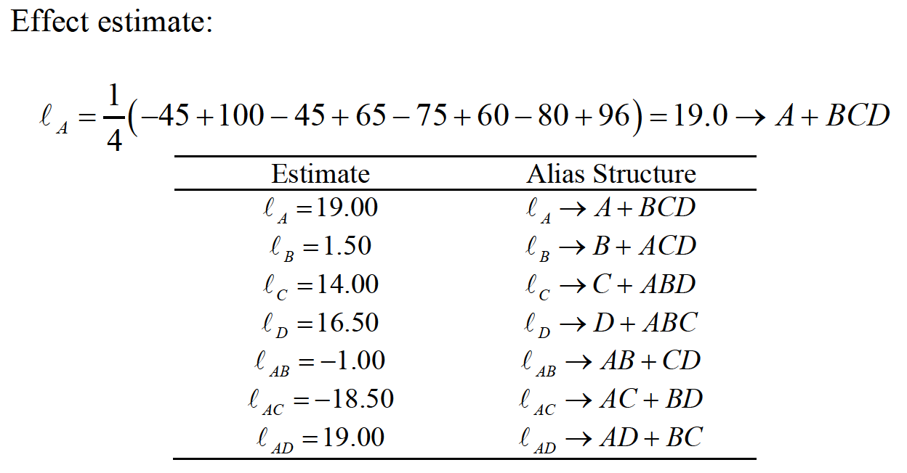
ONE-HALF FRACTION DESIGN

Slide 17
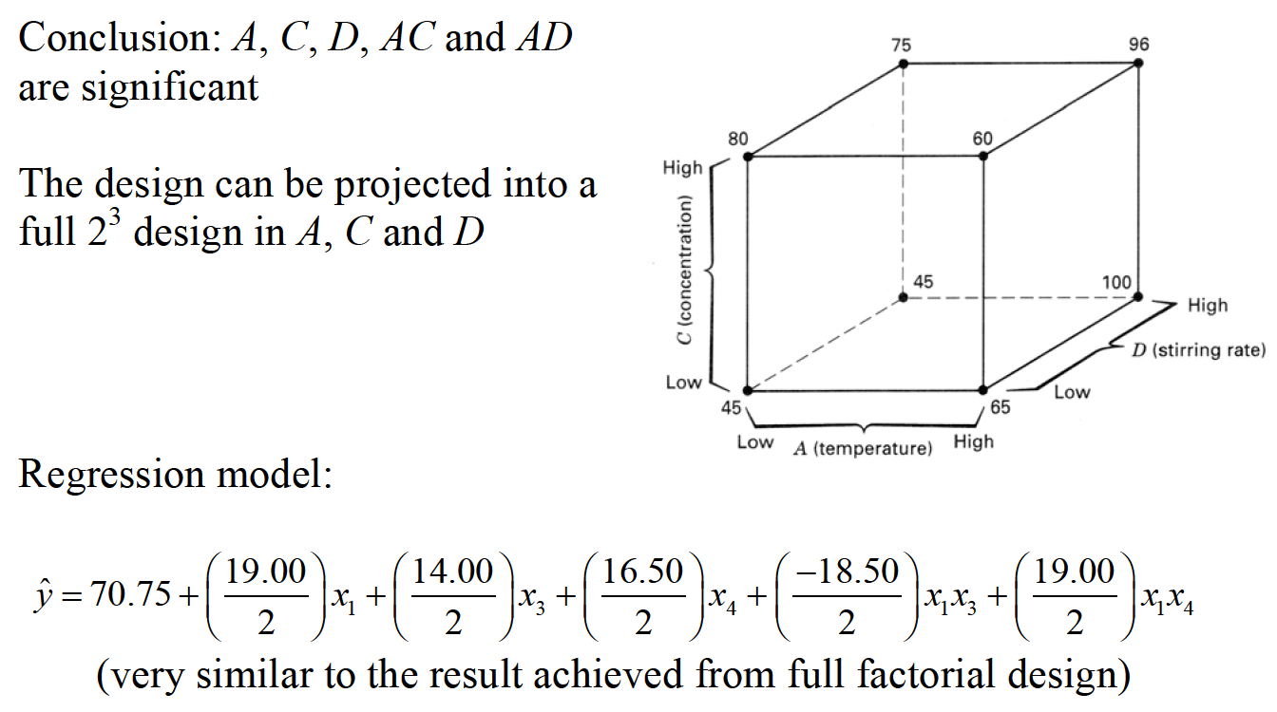
ONE-HALF FRACTION DESIGN

Slide 18
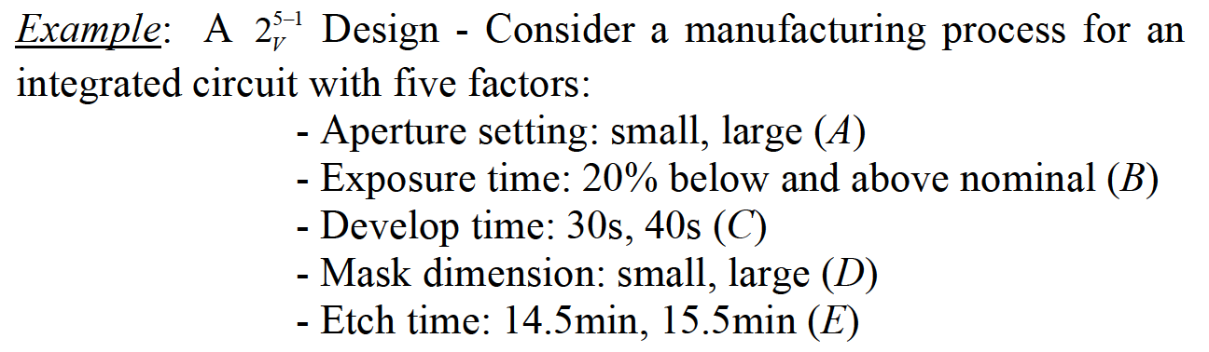
ONE-HALF FRACTION DESIGN

Slide 19
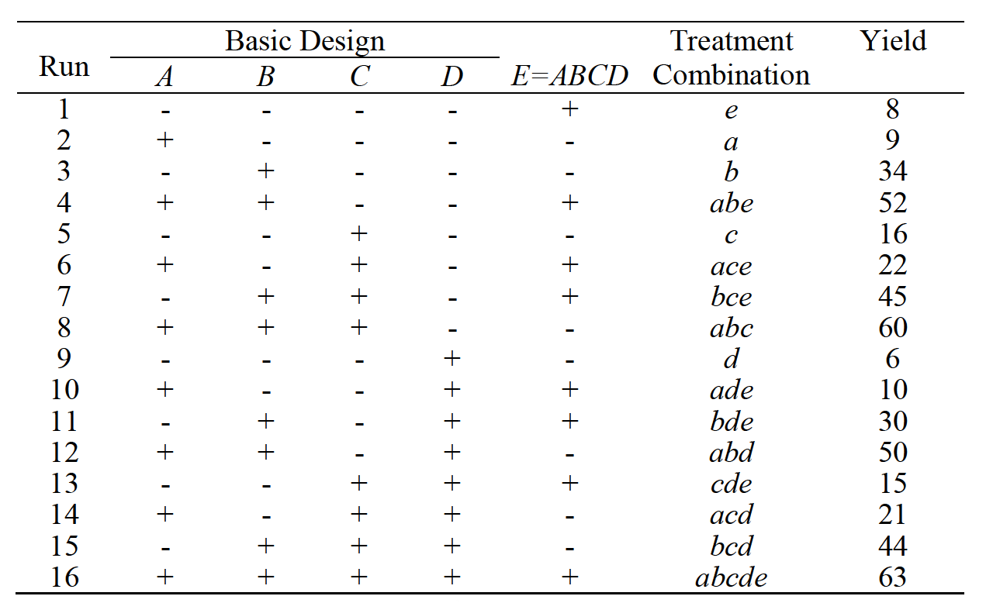
ONE-HALF FRACTION DESIGN

Slide 20
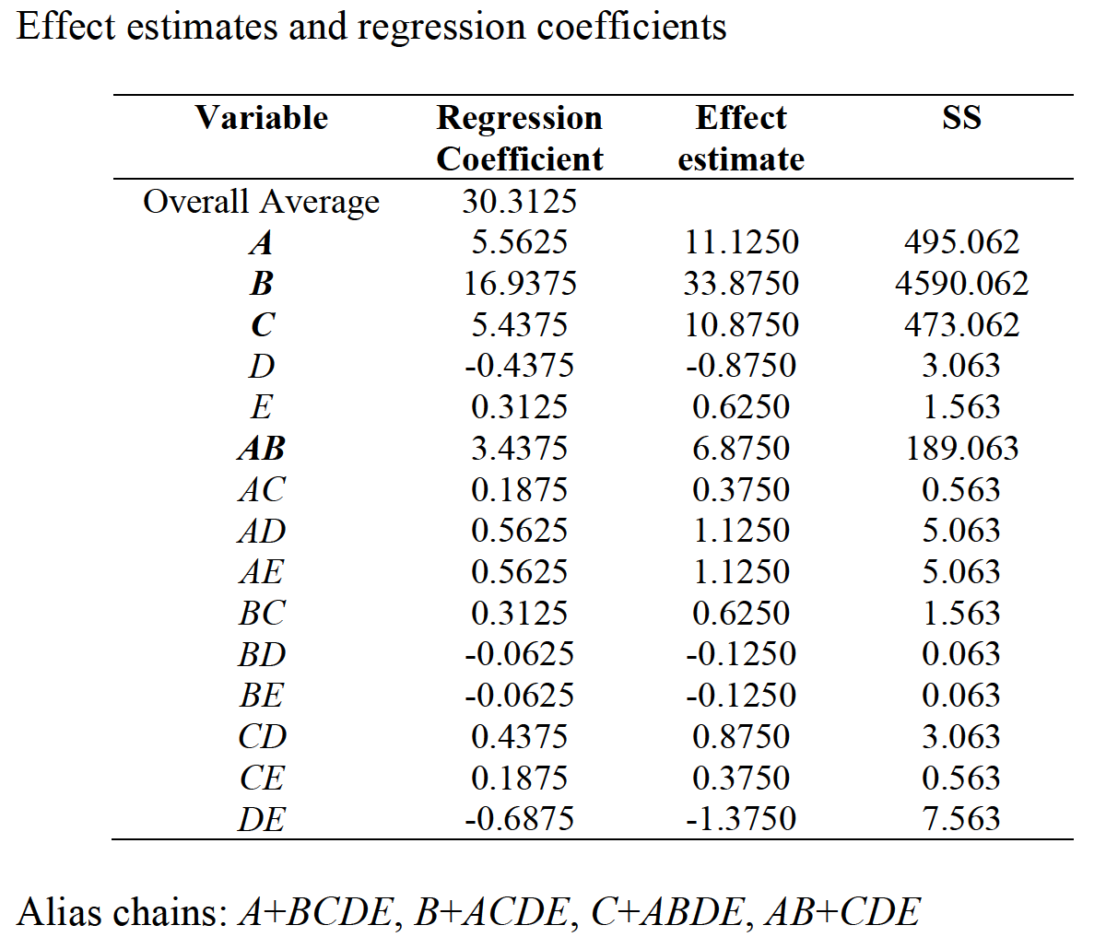
ONE-HALF FRACTION DESIGN

Slide 21
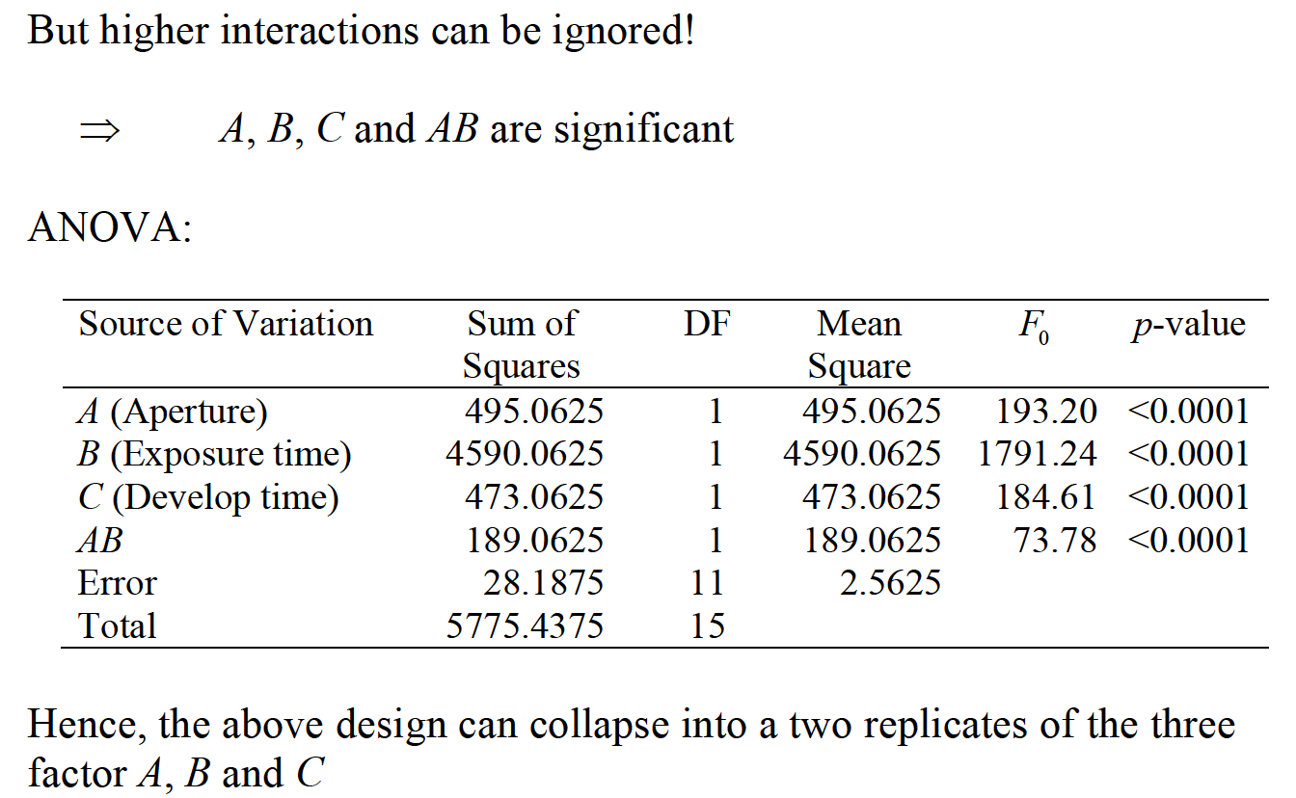
ONE-HALF FRACTION DESIGN

Slide 22
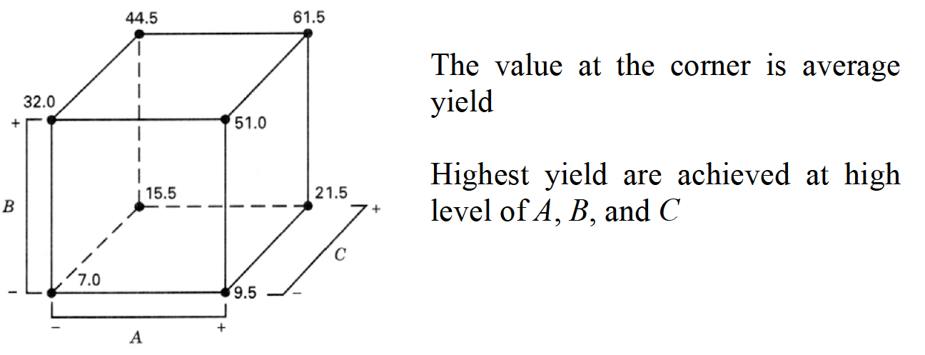
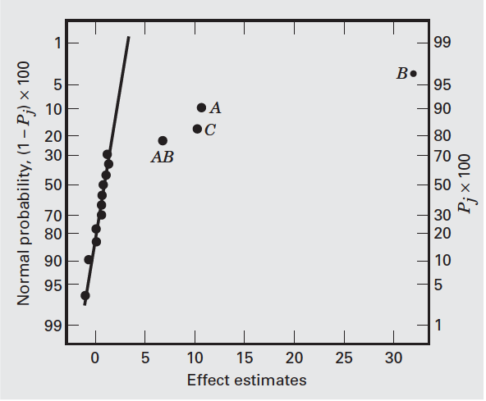
ONE-HALF FRACTION DESIGN

Slide 23
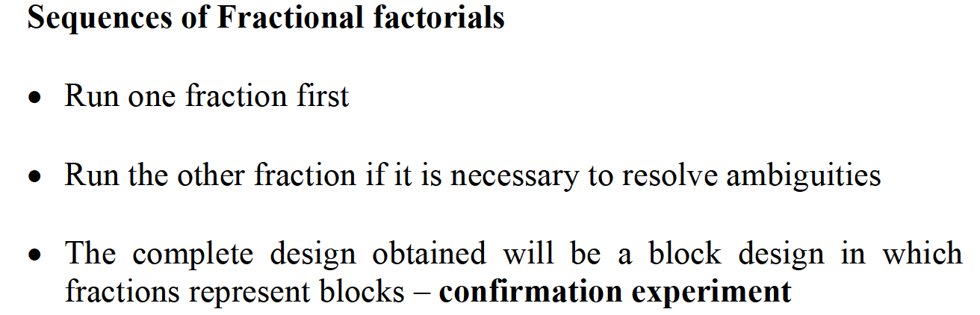
ONE-HALF FRACTION DESIGN

Slide 24
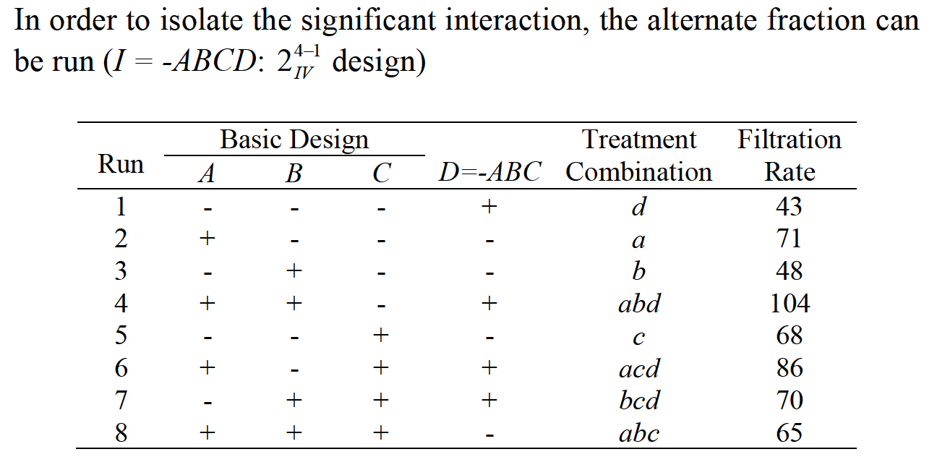
ONE-HALF FRACTION DESIGN

Slide 25
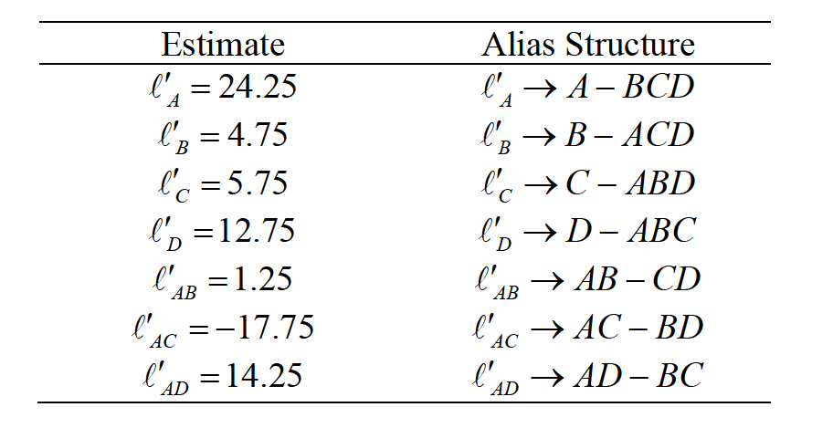
ONE-HALF FRACTION DESIGN

Slide 26
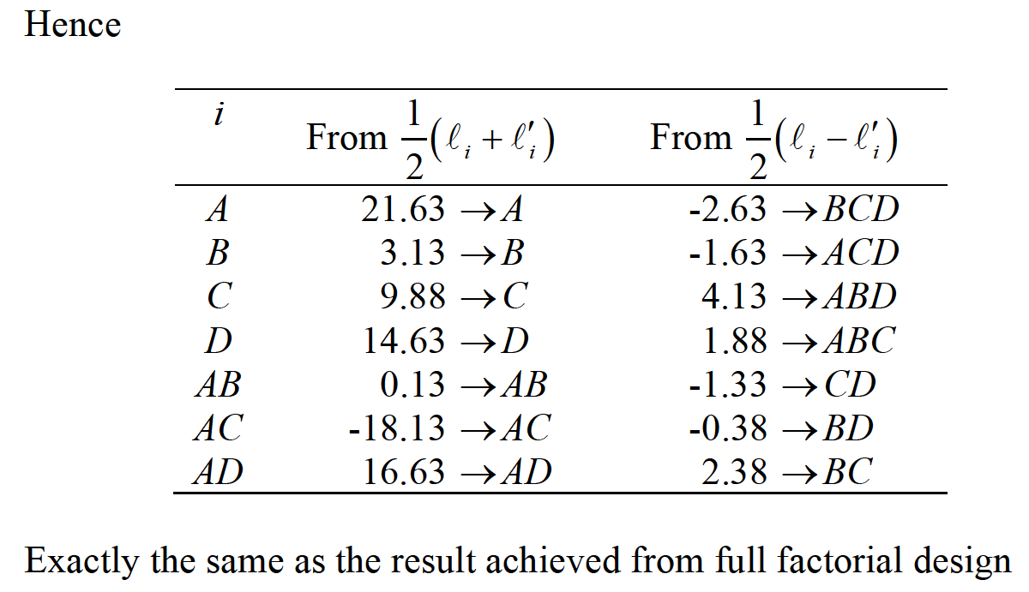
ONE-HALF FRACTION DESIGN

Slide 27
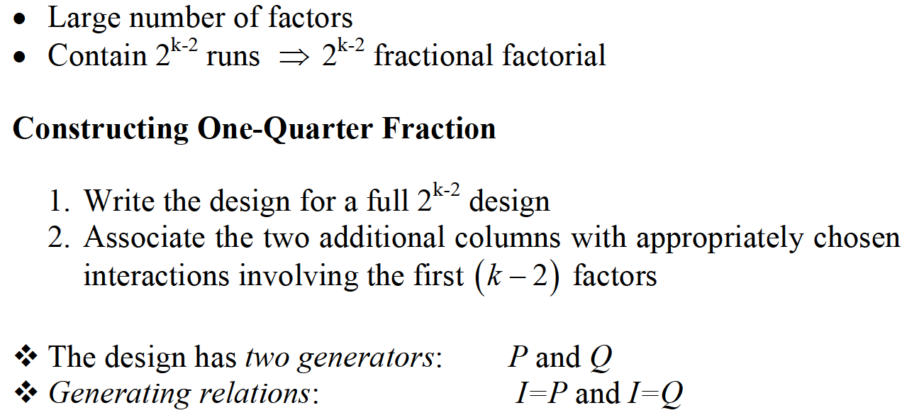
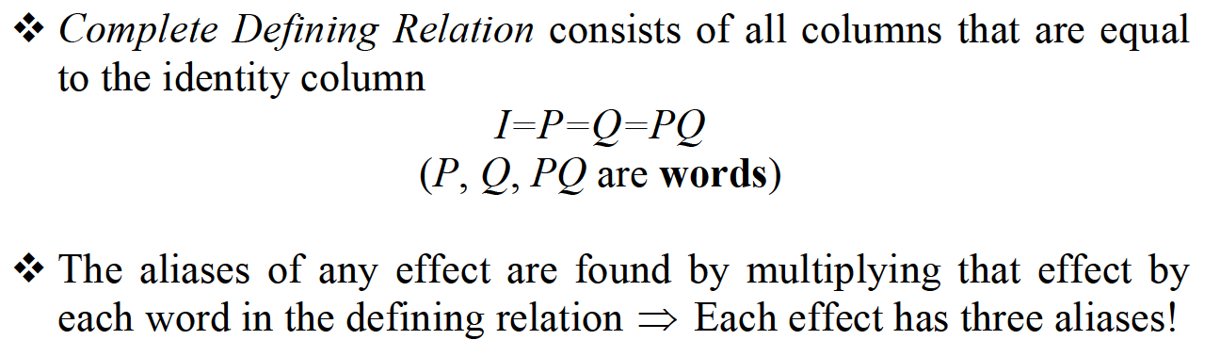
ONE-QUARTER FRACTION DESIGN

Slide 28
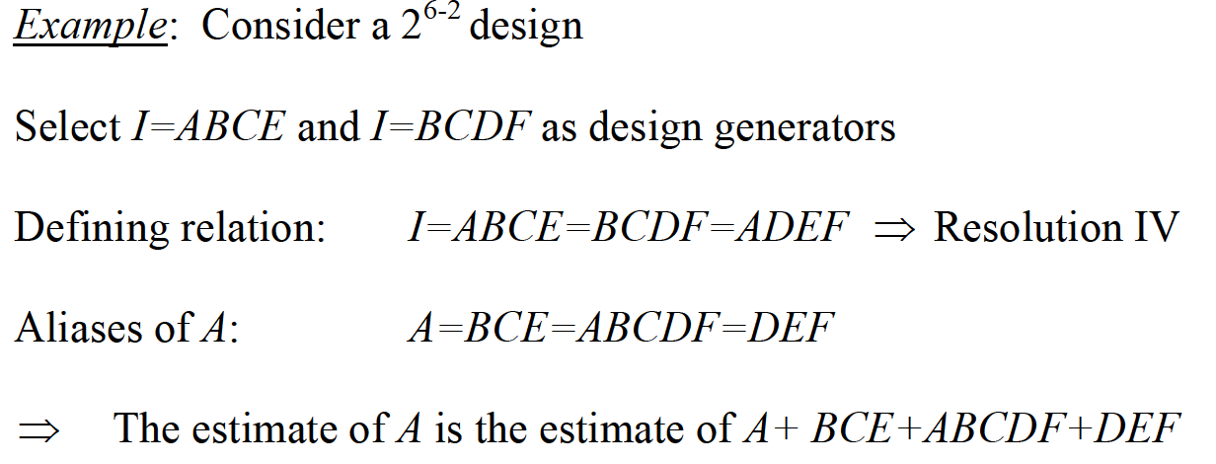
ONE-QUARTER FRACTION DESIGN

Slide 29
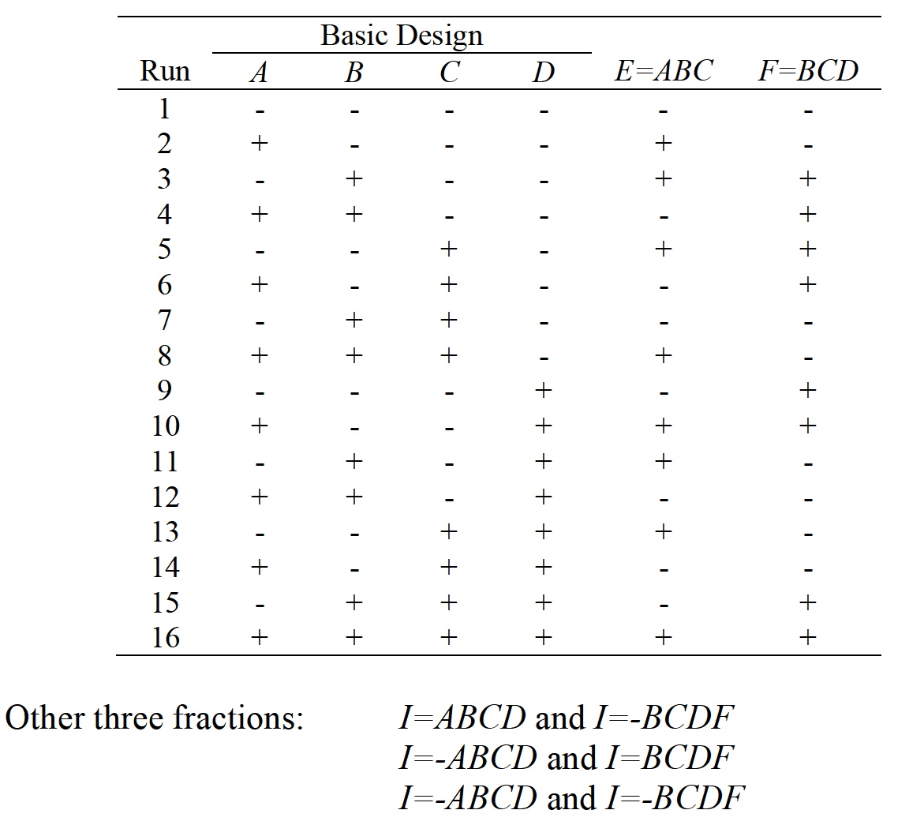
ONE-QUARTER FRACTION DESIGN

Slide 30
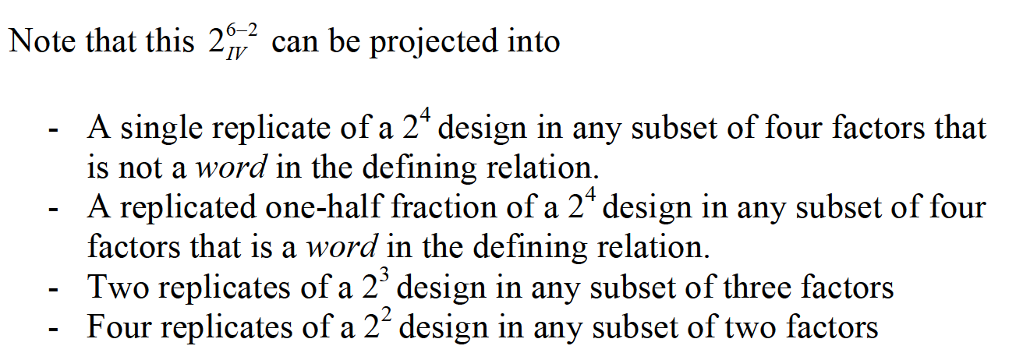
ONE-QUARTER FRACTION DESIGN

Slide 31
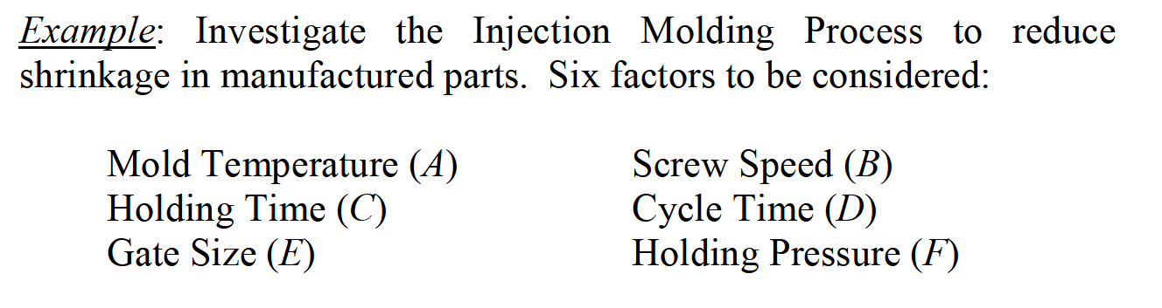
ONE-QUARTER FRACTION DESIGN

Slide 32
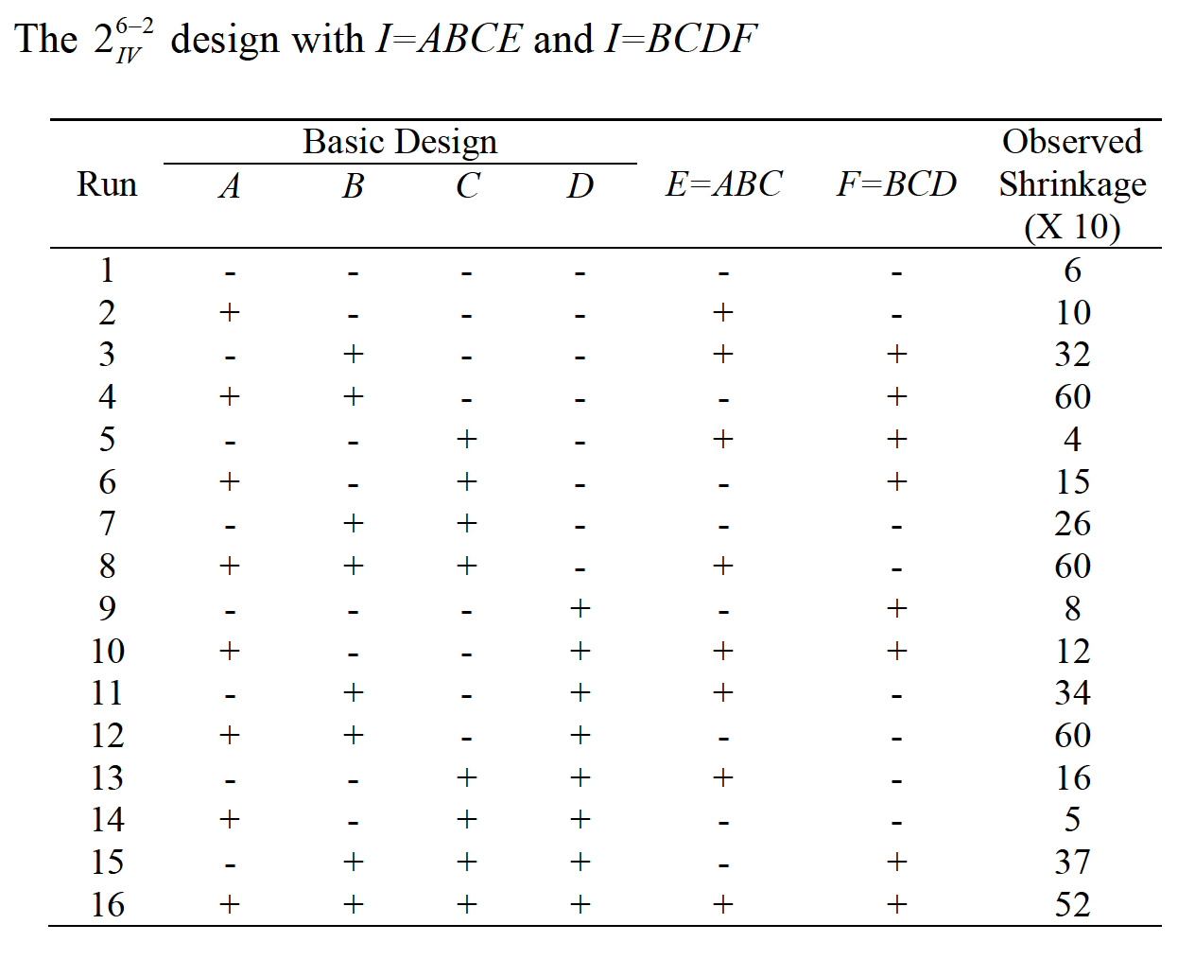
ONE-QUARTER FRACTION DESIGN

Slide 33
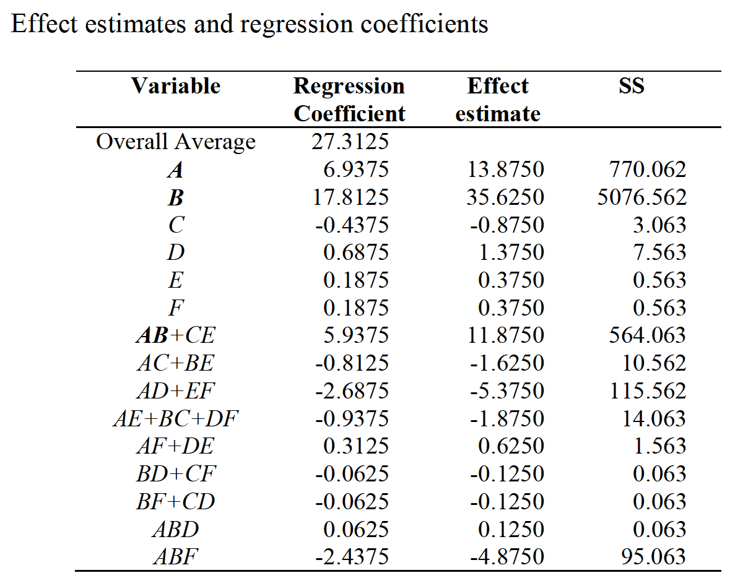
ONE-QUARTER FRACTION DESIGN

Slide 34
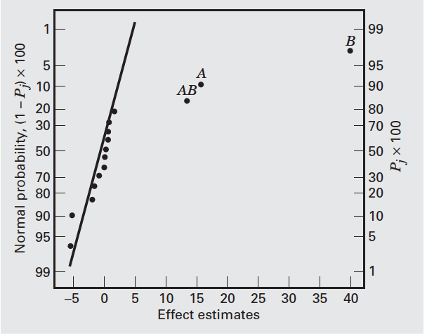
ONE-QUARTER FRACTION DESIGN

Slide 35
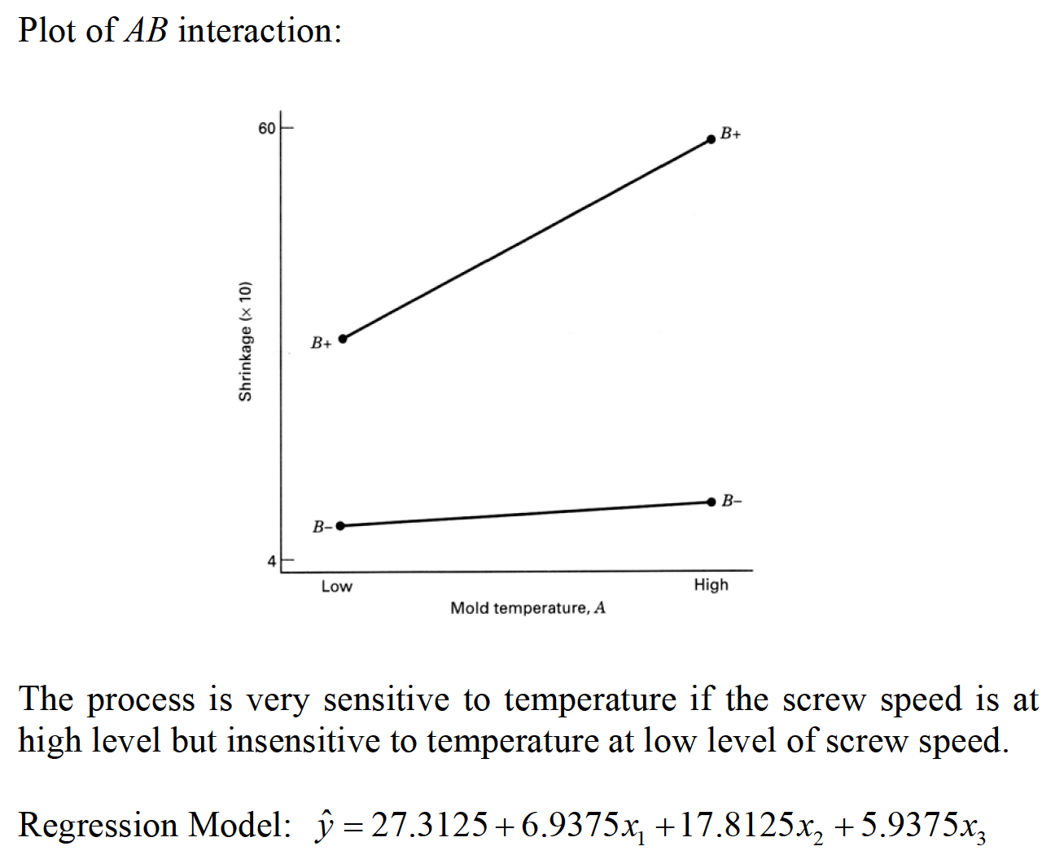
ONE-QUARTER FRACTION DESIGN

Slide 36
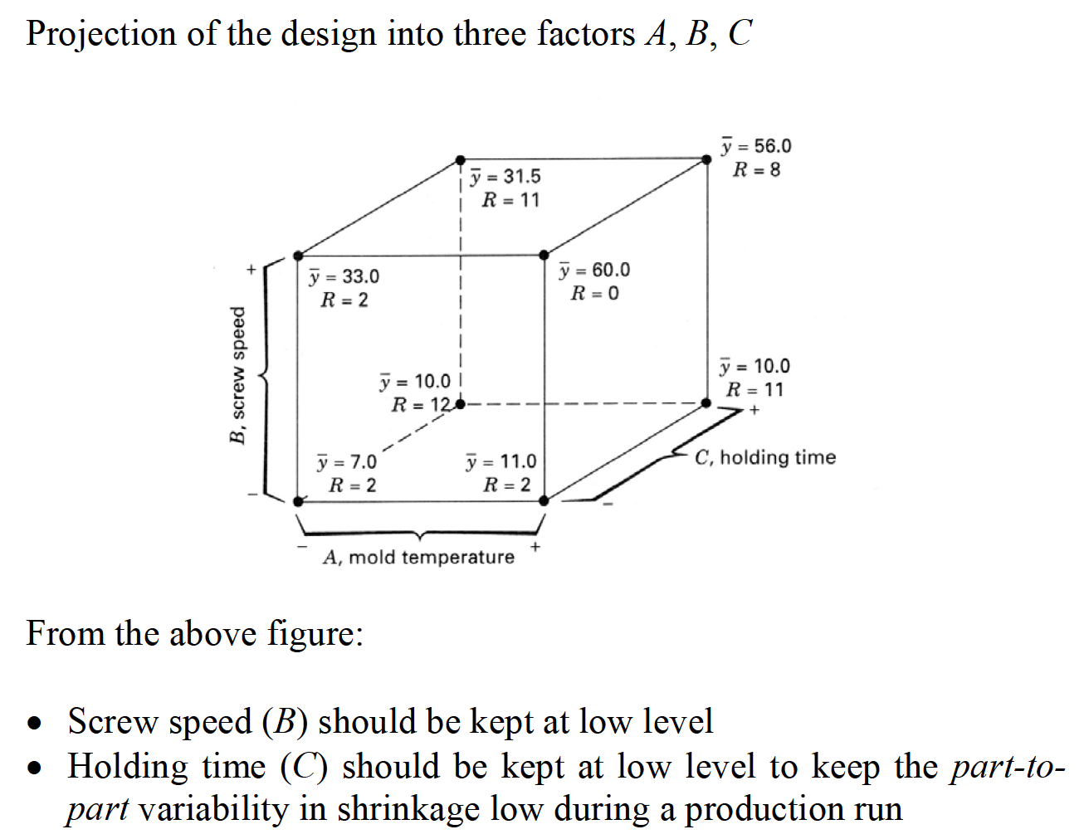
ONE-QUARTER FRACTION DESIGN

